Slide 1

Data Science – A deep dive
Team: AnotherDayAnotherData Team Members: Rosario, Smiti, Tejas, Stephanie

Slide 2
Project Overview
With the increase in data and data science skills in the job market, this project aims to look at the data from various job boards and build visualizations on how the job market has changed over the last year and where data science skills stand in the job market.

Slide 3
Research Points
Job concentration in the US
Change in Data Science jobs over time
Breakdown of Data Science job roles
Skills in Data Science field
Job board comparison
Salary Range for Data Science jobs

Slide 4
Data Exploration
During our data exploration process we realized that there were limitations.
We used Kaggle and JobsPikrAPI for our dataset.
We used google maps to plot heat maps to be able to display the concentration of jobs in different state.

Slide 5
Data Cleanup and Analysis
We will present Jupyter Notebook

Slide 6
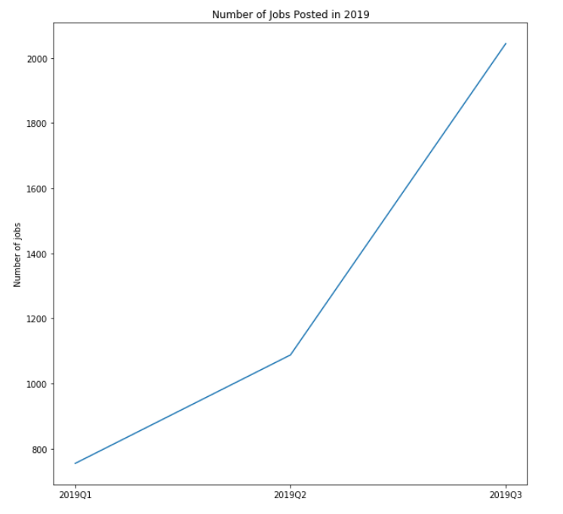
How has the demand in Data Science jobs changed in a span of 1 year?
With the data that we have collected we have seen that the number of jobs has increased.
2019Q2 increased 1.5x than Q1
2019Q3 increased 2.7x than Q1

Slide 7
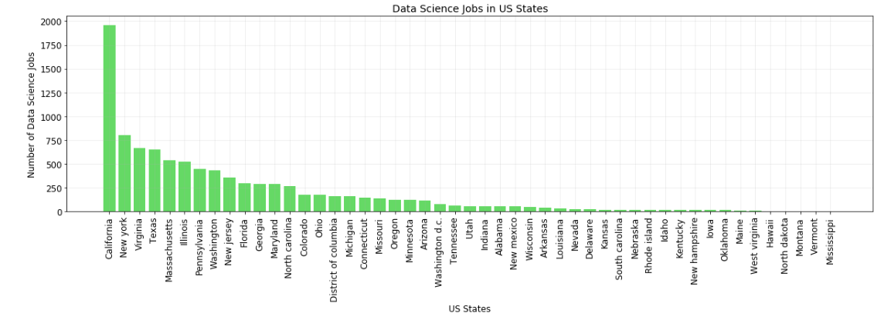
Job concentration in the US
From this graph we can see that most Data Science jobs are in California doubles in comparison of other States.

Slide 8
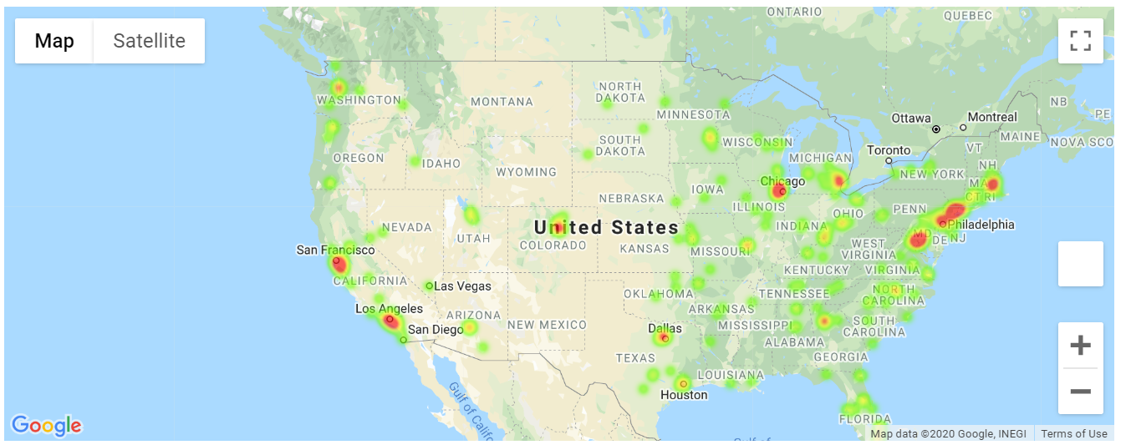
Job concentration in the US Pt 2

Slide 9
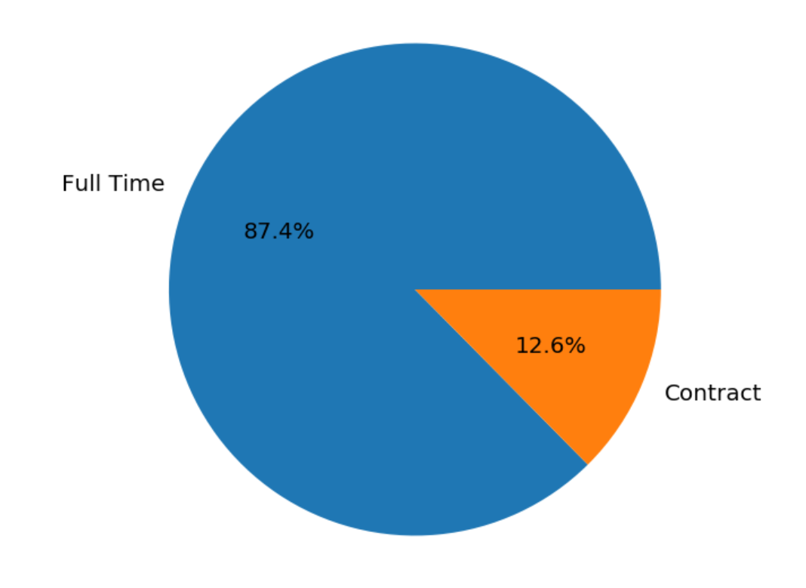
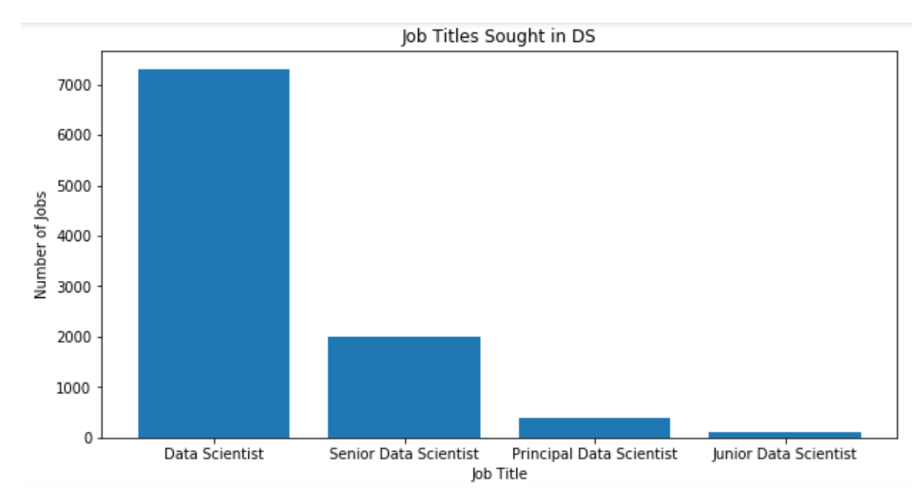
Breakdown of Data Science job roles
There are more Full Time jobs than contract jobs posted

Slide 10
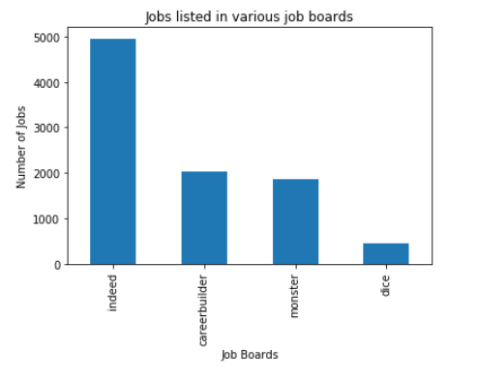
Job Board Comparison
The indeed job board list more jobs related to Data Scientist roles.

Slide 11
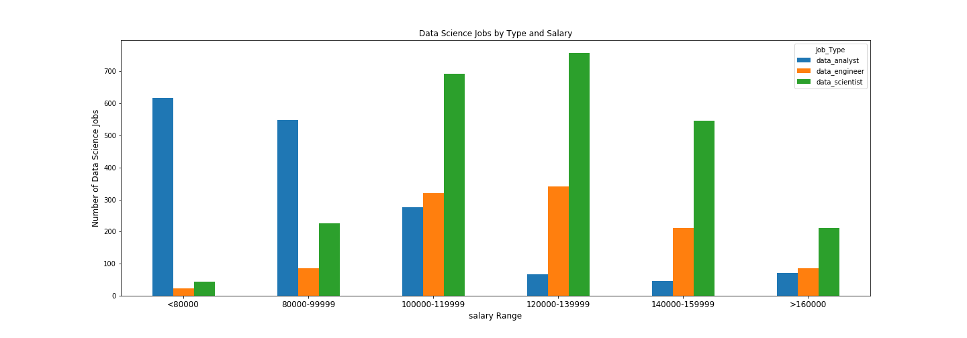
Salary Range by job type
Data Scientist is the highest paying role among the data professionals

Slide 12
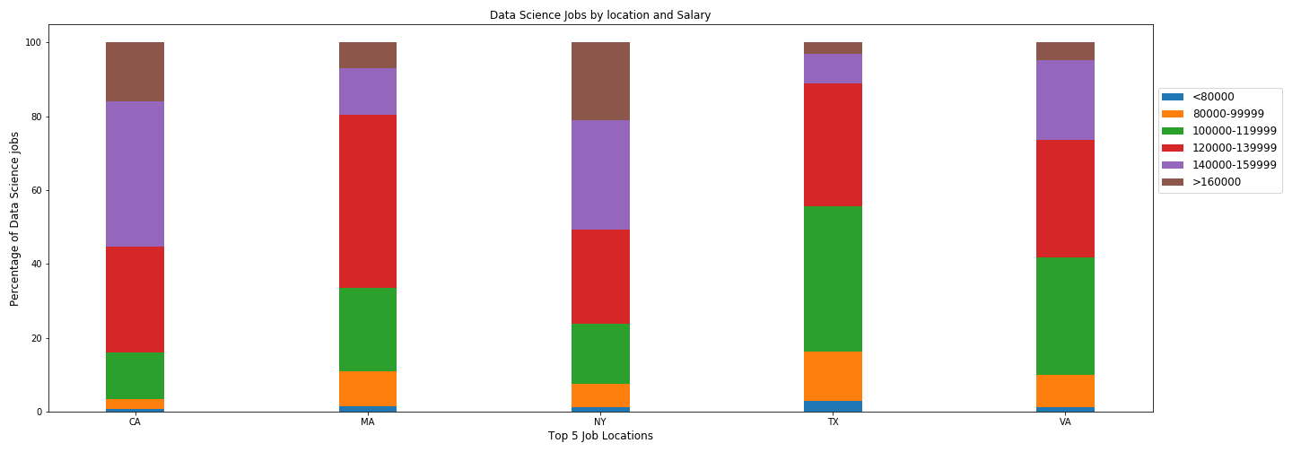
Salary range by location
From the previous slide we can see that California hires more Data professionals. However, the highest paying state is New York.

Slide 13
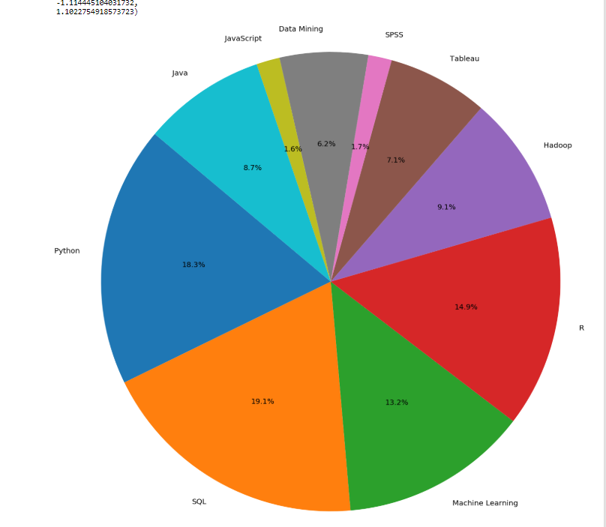
Skills in Data Science field
On Demand Skills in the Data Science fields are
Python
SQL
R
Machine Learning
75% of job listings request the above skills.

Slide 14
Conclusions
The Data Science field is a growing field.
The most sought after skills we will acquire by the end of this bootcamp.
From the data we can see that we all are on the right track.

Slide 15


